Slide 1

Moving our entire team to R Public Profit
Notes:
We recently

Slide 2
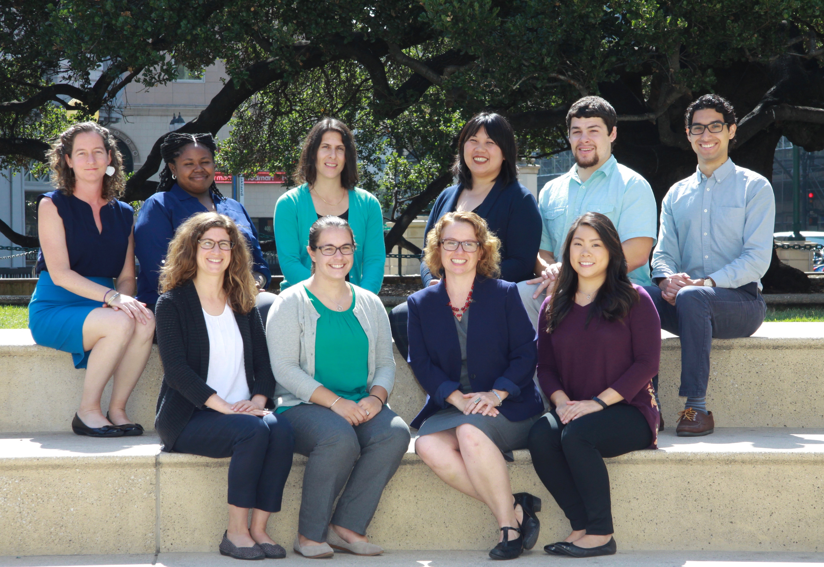
Who we are
10 people
Spirit of hands on, on the job learning
Value documentation
Experience writing SPSS syntax
Our data work
Notes:
10 people
spirit of hands on, on the job learning (many people learned SPSS on this job)
spirit of: write down your steps so someone else (or your future forgetful self) should be able to follow your steps
our data work
mostly descriptives, tables
data visualization is very important to us!
frequent multi-site projects (one survey but reported out descriptively by site)

Slide 3

The Break Up
Public Profit
SPSS
Notes:
Why we decided to leave SPSS and take the leap to R
Lack of support
Licensing issues
Cost
Less popular (new staff less likely to be familiar with it)
Popularity of R – wave of the future
Last year, we decided to break up with SPSS and take the leap to R. It was not an easy decision to make. Being consultants, we need to be able to work quickly and efficiently in highly interdependent teams, something that we did well using SPSS. We had years of shared syntax, systems, and norms built around this data analysis software that allowed us to meet constant deadlines in a busy evaluation consulting business.

Slide 4

Ensuring Success
Notes:
What does success look like?
In order to ensure success in our transition to R, we brought in outside consultants to formalize the process, determined strategies to bring our team up to speed across roles, and outlined internal accountability.
Four things really helped us move forward quickly and we would recommend to anyone taking the leap to R:
Form a Pilot team
Create Norms and Best Practices
Ensure Accountability and Practice
Make it fun!
I’ll talk about each of these in more detail.

Slide 5

1. Pilot Team
Notes:
We identified a Pilot Team to take the lead in learning R.
This team consisted of 4 folks across roles who had experience working with data in SPSS.
We hired outside help to provide direct training to the Pilot Team and get us up to speed quickly.
The Pilot Team helped us have in house 'experts' and identify how R would fit into our collaborative work setting when it came time, a few months later, to train the whole team.

Slide 6

2. Norms and Best Practices
Notes:
Norms and Best Practices - we crafted norms and best practices for how we would work in R
We needed to make sure we were all moving in the same direction and using R in the same way.
It was challenging to avoid the temptation of using our SPSS norms and best practices for R.
In practice, the ways we worked in SPSS did not always translate over to R (for example, R does not allow for value labels, which we’d relied on heavily in SPSS).
The Pilot Team helped us outline some internal norms and best practices to start; the rest of the team continues to identify and add to this list.
EXAMPLES:

Slide 7

3. Accountability and Practice
Notes:
In order to ensure all staff had first-hand experience writing and running code we identified a real dataset for each person, across all roles, to clean and analyze in R for a real external deadline.
The Pilot Team held 'office hours' to help staff as they cleaned and analyzed their data.
….

Slide 8

4. R Parties!
Notes:
R Parties!
In order to encourage continued learning and collaboration, we hold R Parties.
At these we share cool code, quick tips, or ideas for how to improve our processes.
Everyone learns something new, is given the opportunity to share, and leaves with new ideas for how to improve our work using R.
People we shared cool code, quick tips, or ideas for how to improve our processes.
It is amazing how well these have been received by our staff. Just by calling it a party! People love the opportunity to learn and share.

Slide 9
Shifting our Mentality
“Can you do that in R?”
"You can do that in R! (and I'll figure out how.)"
Notes:
The effect if had:
Through these strategies, over the course of a year we were able to shift our team’s mentality from “Can we do that in R?” to "We can do that in R! (and I'll figure out how.)"
We are still learning and growing our R skills

Slide 10
THANK YOU! http://bit.ly/benefitsofR
David Keyes – R for the Rest of Us
Eric Einspruch - ELE Consulting
Dana Wanzer – University of Wisconsin, Stout
Tom McKlin - The Findings Group
Ava Elliott - Public Profit
Notes:
We recently

